Slide 1
Fundamentals of Machine Learning
Linear Algebra- Cholesky Decomposition

Slide 2
Outline
Matrix Decomposition – Introduction
Cholesky Decomposition
Solution of Linear system of equations using Cholesky Decomposition

Slide 3
Matrix Decomposition ( a.k.a Matrix Factorization)
Many complex matrix operations cannot be solved efficiently or with stability using the limited precision of computers.
Matrix decompositions are methods that reduce a matrix into constituent parts that make it easier to calculate more complex matrix operations.
Matrix decomposition methods, also called matrix factorization methods can be used for for
systems of linear equations
calculating the inverse,
calculating the determinant of a matrix.

Slide 4
Matrix decomposition
Matrix decomposition is a method to split a matrix into its constituent parts.
It simplifies more complex matrix operations that can be performed on the decomposed matrix rather than on the original matrix itself.
A common analogy for matrix decomposition is the factoring of numbers, such as the factoring of 15 into 3 x 5.
Widely used matrix decomposition methods are
LU matrix decomposition
QR Decomposition
Cholesky decomposition
SVD decomposition

Slide 5
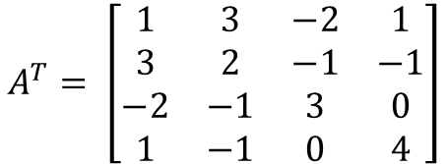
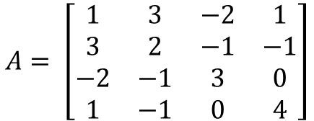
Cholesky decomposition
Cholesky decomposition: Every symmetric, positive definite matrix M can be decomposed into a product of a unique lower triangular matrix L and its transpose L^{T}.
A=LL^{T}
A square matrix A_{n x n} is said to be symmetric, if a_{ij}=a_{ji}, for i=1..n and j=1..n
i.e., A=A^{T}
$$A= \left[\begin{matrix}1 & 3 & −2 & 1 \\ 3 & 2 & −1 & −1 \\ −2 & −1 & 3 & 0 \\ 1 & −1 & 0 & 4\end{matrix}\right]$$
A=A^{T}
$$A^{T}= \left[\begin{matrix}1 & 3 & −2 & 1 \\ 3 & 2 & −1 & −1 \\ −2 & −1 & 3 & 0 \\ 1 & −1 & 0 & 4\end{matrix}\right]$$

Slide 6
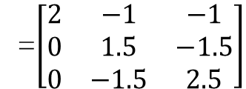
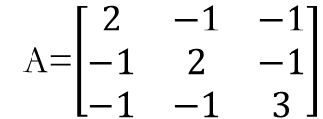
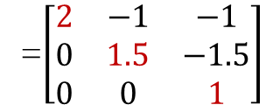
Positive Definite Matrix
A matrix is positive definite if it is symmetric and all its pivots are positive
Apply Gaussian elimination method to find the pivot elements. Pivots are the first non-zero element in each row the matrix.
Example
A=$\left[\begin{matrix}2 & −1 & −1 \\ −1 & 2 & −1 \\ −1 & −1 & 3\end{matrix}\right]$
R₂←R₂+(1/2)×R₁
R₃←R₃+(1/2)×R₁
=$\left[\begin{matrix}2 & −1 & −1 \\ 0 & 1.5 & −1.5 \\ 0 & −1.5 & 2.5\end{matrix}\right]$
=$\left[\begin{matrix}2 & −1 & −1 \\ 0 & 1.5 & −1.5 \\ 0 & 0 & 1\end{matrix}\right]$
Pivots are 2, 1.5 and 1. All pivots are positive. Hence A is a positive definite matrix
R3←R3+R2

Slide 7
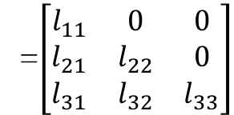
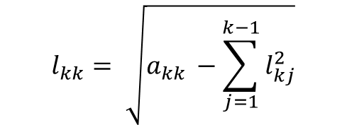
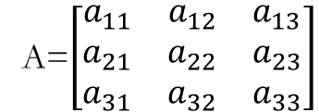
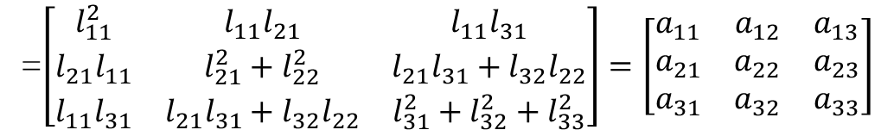

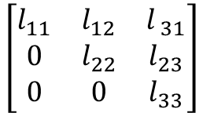
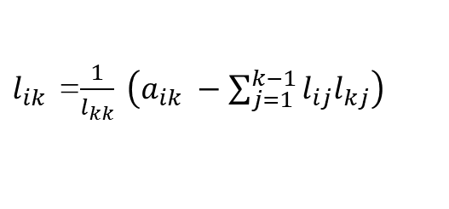
Cholesky Decomposition
A=L⋅L^{T}, Every symmetric positive definite matrix A can be decomposed into a product of a unique lower triangular matrix L and its transpose.
In general, the diagonal elements are computed using the formula
Example
A=$\left[\begin{matrix}a_{11} & a_{12} & a_{13} \\ a_{21} & a_{22} & a_{23} \\ a_{31} & a_{32} & a_{33}\end{matrix}\right]$
$$l_{kk}= \sqrt{a_{kk }−\sum_{j=1}^{k−1}{l_{kj}^{2}}}$$
=$\left[\begin{matrix}l_{11} & 0 & 0 \\ l_{21} & l_{22} & 0 \\ l_{31} & l_{32} & l_{33}\end{matrix}\right]$
$$\left[\begin{matrix}l_{11} & l_{12} & l_{ 31} \\ 0 & l_{22} & l_{23} \\ 0 & 0 & l_{33}\end{matrix}\right]$$
$$=LLT$$
The elements below the diagonal $l_{ik }$(i>k) can be expressed as
$l_{ik }$ =$\frac{1}{l_{kk}} \left(a_{ik} −\sum_{j=1}^{k−1}{l_{ij}l_{kj}}\right)$
=$\left[\begin{matrix}l_{11}^{2} & l_{11}l_{21} & l_{11}l_{31} \\ l_{21}l_{11} & l_{21}^{2}+l_{22}^{2} & l_{21}l_{31}+l_{32}l_{22} \\ l_{11}l_{31} & l_{21}l_{31}+l_{32}l_{22} & l_{31}^{2}+l_{32}^{2}+l_{33}^{2}\end{matrix}\right]=\left[\begin{matrix}a_{11} & a_{12} & a_{13} \\ a_{21} & a_{22} & a_{23} \\ a_{31} & a_{32} & a_{33}\end{matrix}\right]$

Slide 8

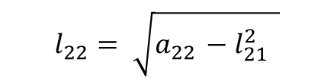
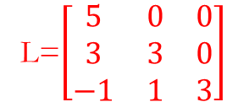
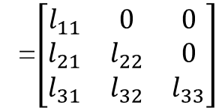



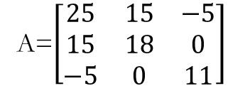
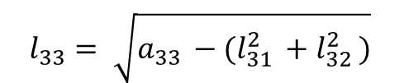
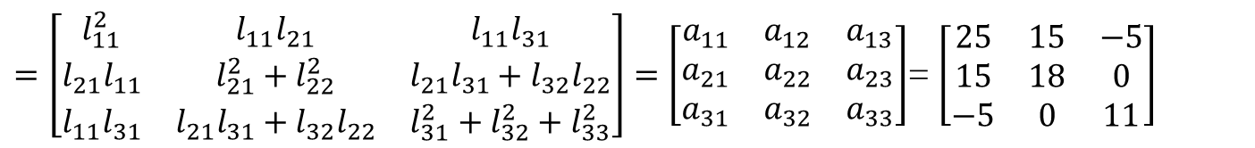




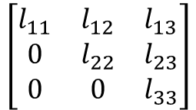


Example : Decompose the matrix A using Cholesky decomposition method
A=$\left[\begin{matrix}25 & 15 & −5 \\ 15 & 18 & 0 \\ −5 & 0 & 11\end{matrix}\right]$
Express the matrix A into the form
=$\left[\begin{matrix}l_{11} & 0 & 0 \\ l_{21} & l_{22} & 0 \\ l_{31} & l_{32} & l_{33}\end{matrix}\right]$
$$\left[\begin{matrix}l_{11} & l_{12} & l_{13} \\ 0 & l_{22} & l_{23} \\ 0 & 0 & l_{33}\end{matrix}\right]$$
$$=LLT$$
$=\left[\begin{matrix}l_{11}^{2} & l_{11}l_{21} & l_{11}l_{31} \\ l_{21}l_{11} & l_{21}^{2}+l_{22}^{2} & l_{21}l_{31}+l_{32}l_{22} \\ l_{11}l_{31} & l_{21}l_{31}+l_{32}l_{22} & l_{31}^{2}+l_{32}^{2}+l_{33}^{2}\end{matrix}\right]=\left[\begin{matrix}a_{11} & a_{12} & a_{13} \\ a_{21} & a_{22} & a_{23} \\ a_{31} & a_{32} & a_{33}\end{matrix}\right]$= $\left[\begin{matrix}25 & 15 & −5 \\ 15 & 18 & 0 \\ −5 & 0 & 11\end{matrix}\right]$
L=$\left[\begin{matrix}5 & 0 & 0 \\ 3 & 3 & 0 \\ −1 & 1 & 3\end{matrix}\right]$
$$l_{11}= \sqrt{a_{11 } }$$
$$= \sqrt{25}$$
$=$5
$$l_{22}= \sqrt{a_{22 }−l_{21 }^{2} }$$
$=\sqrt{18−3^{2}} =\sqrt{9}$ =3
$$l_{21}= \frac{1}{l_{11}}\left(a_{12}\right)$$
$=\frac{1}{5}$$\left(15\right)$ =3
$l_{32}= \frac{1}{l_{22}}\left(a_{32} −l_{31}l_{21}\right)$ = $\frac{1}{3}$$\left(0−(−1x3)\right)$ =1
$l_{31}= \frac{1}{l_{11}}\left(a_{31}\right)$ = $\frac{1}{5}$$\left(−5\right)$ =$−1$
$$l_{33}= \sqrt{a_{33 }−(l_{31 }^{2 }+l_{32 }^{2 })}$$
$=\sqrt{11−{((−1}^{2})+(1^{2})} =\sqrt{9}$ =3

Slide 9
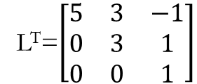
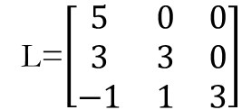
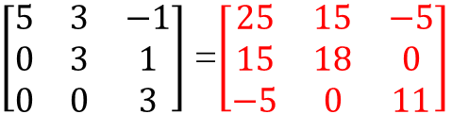
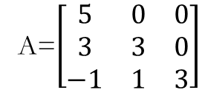
L=$\left[\begin{matrix}5 & 0 & 0 \\ 3 & 3 & 0 \\ −1 & 1 & 3\end{matrix}\right]$
L^{T}=$\left[\begin{matrix}5 & 3 & −1 \\ 0 & 3 & 1 \\ 0 & 0 & 1\end{matrix}\right]$
A=$\left[\begin{matrix}5 & 0 & 0 \\ 3 & 3 & 0 \\ −1 & 1 & 3\end{matrix}\right]$
$\left[\begin{matrix}5 & 3 & −1 \\ 0 & 3 & 1 \\ 0 & 0 & 3\end{matrix}\right]$ =$\left[\begin{matrix}25 & 15 & −5 \\ 15 & 18 & 0 \\ −5 & 0 & 11\end{matrix}\right]$

Slide 10
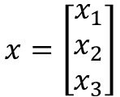
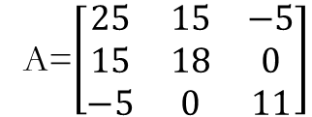
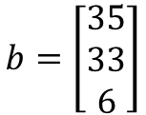
Solution of linear equations using Cholesky Decomposition Method
Algorithm
factor A as A = LL^{T}
solve LL^{T} x = b
let L^{T}x = y, and Ly=b
solve Ly = b using forward substitution for getting y
Solve L^{T}x=y using backward substitution for getting value of x
Example:
25x₁+15x₂-5x₃=35→(1) 15x₁+18x₂+0x₃=33→(2) -5x₁+0x₂+11x₃=6→(3)
A=$\left[\begin{matrix}25 & 15 & −5 \\ 15 & 18 & 0 \\ −5 & 0 & 11\end{matrix}\right]$
$$x=\left[\begin{matrix}x_{1} \\ x_{2} \\ x_{3}\end{matrix}\right]$$
$$b=\left[\begin{matrix}35 \\ 33 \\ 6\end{matrix}\right]$$

Slide 11
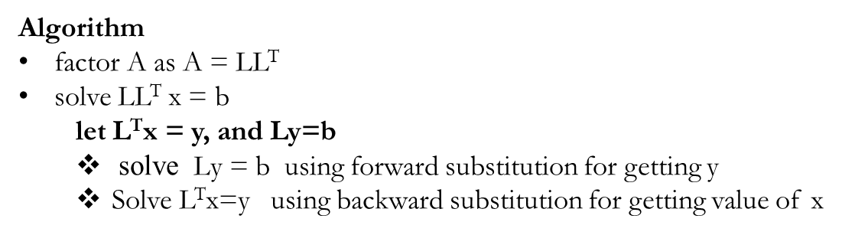
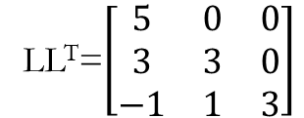
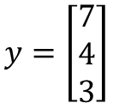
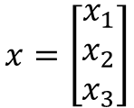

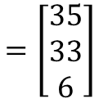
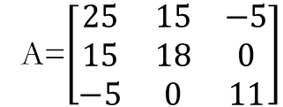
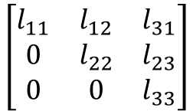
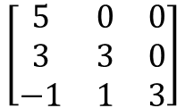
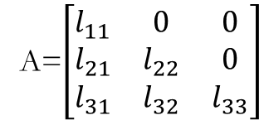

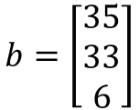
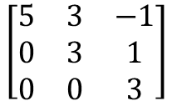
A=$\left[\begin{matrix}25 & 15 & −5 \\ 15 & 18 & 0 \\ −5 & 0 & 11\end{matrix}\right]$
$$x=\left[\begin{matrix}x_{1} \\ x_{2} \\ x_{3}\end{matrix}\right]$$
$$b=\left[\begin{matrix}35 \\ 33 \\ 6\end{matrix}\right]$$
A=$\left[\begin{matrix}l_{11} & 0 & 0 \\ l_{21} & l_{22} & 0 \\ l_{31} & l_{32} & l_{33}\end{matrix}\right]$
$$\left[\begin{matrix}l_{11} & l_{12} & l_{31} \\ 0 & l_{22} & l_{23} \\ 0 & 0 & l_{33}\end{matrix}\right]$$
5y1=35 ------(1)
3y1+3y2=33 ----(2)
-y1+y2+3y3=6 -----(3)
$$=LLT$$
From (3) -y1+y2+3y3=6 ⇒-1(7)+1(4)+3y3=6 ⇒-3+3y3=6 ⇒3y3=6+3=9 ⇒y3=9/3=3
LL^{T}=$\left[\begin{matrix}5 & 0 & 0 \\ 3 & 3 & 0 \\ −1 & 1 & 3\end{matrix}\right]$
$$\left[\begin{matrix}5 & 3 & −1 \\ 0 & 3 & 1 \\ 0 & 0 & 3\end{matrix}\right]$$
Solving using forward substitution,
From (1)
⇒5y1=35 ⇒y1=35/5=7
Now, Ax=b, and A=LL^{T}⇒LL^{T}x=b
let L^{T}x=y, then Ly=b⇒
From (2)
3y1+3y2=33 ⇒3(7)+3y2=33 ⇒21+3y2=33 ⇒3y2=33-21=12 ⇒y2=12/3=4
$$y=\left[\begin{matrix}7 \\ 4 \\ 3\end{matrix}\right]$$
$$\left[\begin{matrix}5 & 0 & 0 \\ 3 & 3 & 0 \\ −1 & 1 & 3\end{matrix}\right]$$
$$\left[\begin{matrix}y_{1} \\ y_{2} \\ y_{3}\end{matrix}\right]$$
$$=\left[\begin{matrix}35 \\ 33 \\ 6\end{matrix}\right]$$

Slide 12

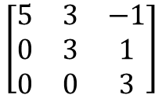
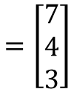
Now, compute L^{T}x=y
From (1) 5x1+3x2-x3=7 ⇒5x1+3(1)-1(1)=7 ⇒5x1+2=7 ⇒5x1=7-2=5 ⇒x1=5/5=1
$$\left[\begin{matrix}5 & 3 & −1 \\ 0 & 3 & 1 \\ 0 & 0 & 3\end{matrix}\right]$$
$$\left[\begin{matrix}x_{1} \\ x_{2} \\ x_{3}\end{matrix}\right]$$
$$=\left[\begin{matrix}7 \\ 4 \\ 3\end{matrix}\right]$$
5x1+3x2-x3=7 --------(1)
3x2+1x3=4 ------(2)
3x3=3 -------(3)
Solution by Cholesky Decomposition method is x1=1, x2=1 and x3=1
Now use back substitution method From (3) 3x3=3 ⇒x3=3/3=1
From (2) 3x2+x3=4 ⇒3x2+1(1)=4 ⇒3x2+1=4 ⇒3x2=4-1=3 ⇒x2=3/3=1

Slide 13
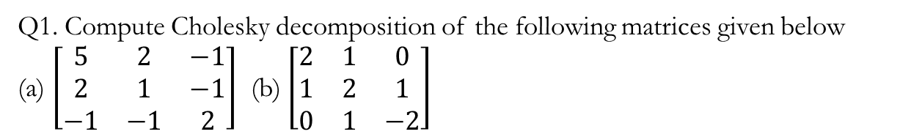
Q1. Compute Cholesky decomposition of the following matrices given below
(a) $\left[\begin{matrix}5 & 2 & −1 \\ 2 & 1 & −1 \\ −1 & −1 & 2\end{matrix}\right]$ (b) $\left[\begin{matrix}2 & 1 & 0 \\ 1 & 2 & 1 \\ 0 & 1 & −2\end{matrix}\right]$
Q2. Solve the following linear system of equations using Cholesky decomposition
5x1+2x2-x3=8
2x1+x2-x3=5
-x1-x2+2x3=10

